Slide 1

Smart Automation Controller
for Precision Agriculture
Design Discussion

Slide 2
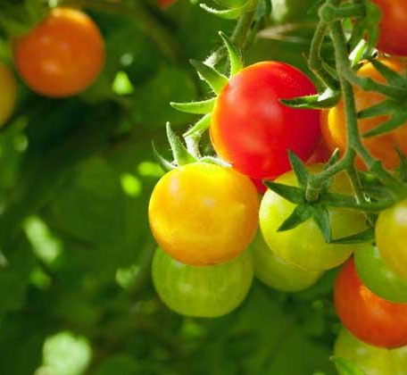
Motivation
Excessive use of pesticides
Precision agriculture
Healthier planet

Slide 3
FPGA vs GPU vs CPU
According to [2] and [3], after testing neural networks on different three platform GPU, CPU and FPGA We found:
NVIDIA GeForce 6800 Ultra (GPU) has a 3.3X speedup compared to the Intel 3GHz P4 (CPU).
FPGA often speeds up the performance by 3-4X compared to GPU.

Slide 4
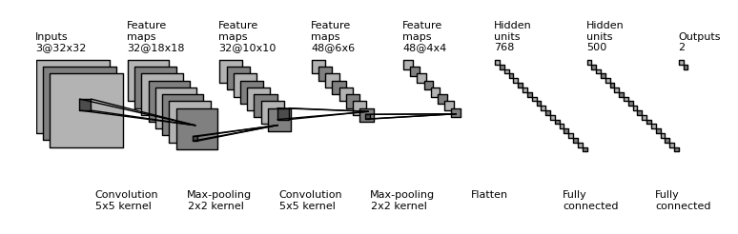
Convolution Neural network - CNN
Convolution neural network contain five main layers:
• Convolution layer
• Pooling layer
• Flatten layer
• Fully connected layer
• Activation function layer

Slide 5

Convolution Layer
A CNN is a neural network with some convolutional layers (and some other layers). A convolutional layer has several filters that does convolutional operation.

Slide 6
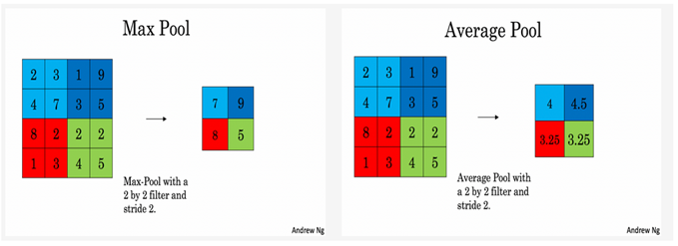
Pooling layer
Non-linear downsampling to simplify the information in output from convolutional layer.
Variants:
Max pooling (popular)
Weighted average
Sum pooling

Slide 7
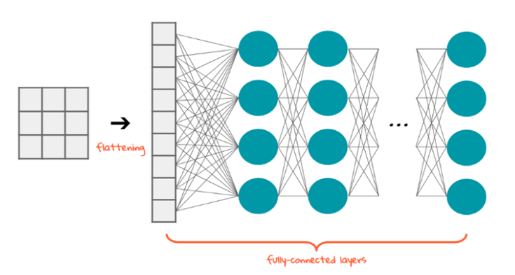
Flatten layer
Flattening is converting the data into a 1-dimensional array for inputting it to the fully connected layer.

Slide 8
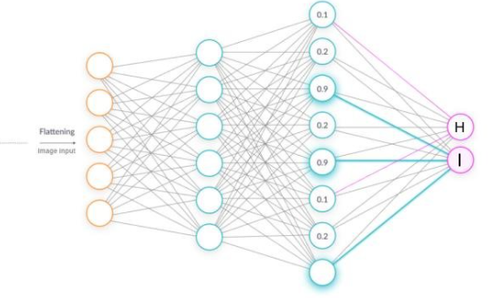
Fully connected layer
Contains neurons that connect to the entire input volume, as in ordinary Neural Networks.

Slide 9
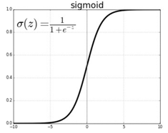
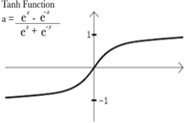
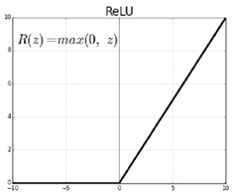
Activation function
Sigmoid
Tanh
Rectified Linear Unit (RELU)

Slide 10
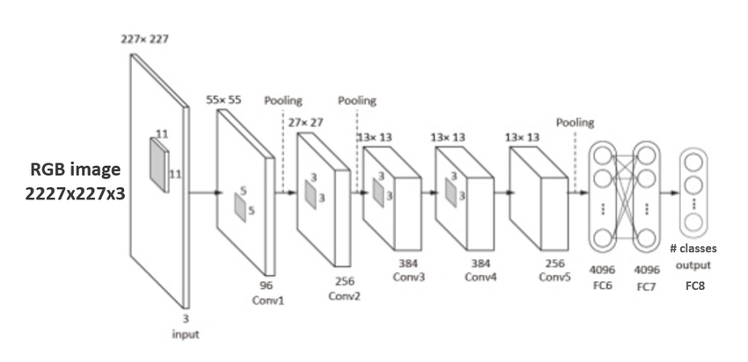
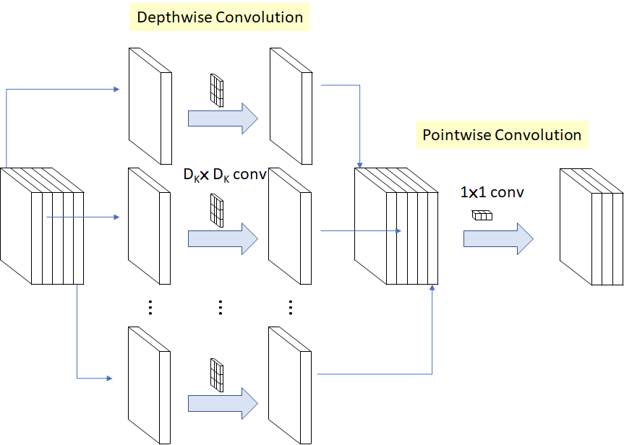
Model architectures
Alexnet
Which depends on standard convolution.
Mobilenet
Which depends on depthwise convolution

Slide 11
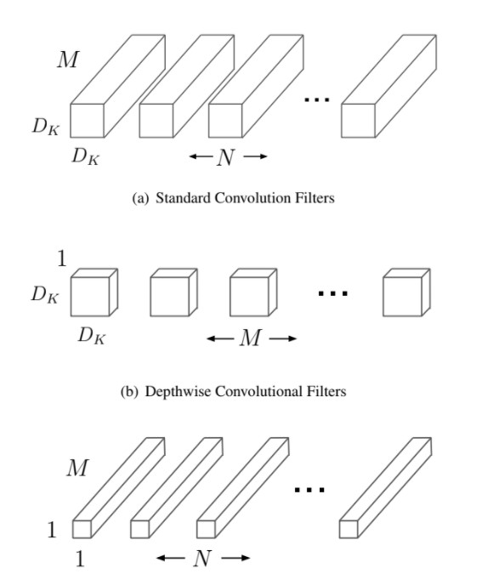
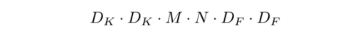
Standard convolution
It works by filtering features using convolutional kernels and then combining them to create new representations.
Complexity of Standard convolution operation:

Slide 12
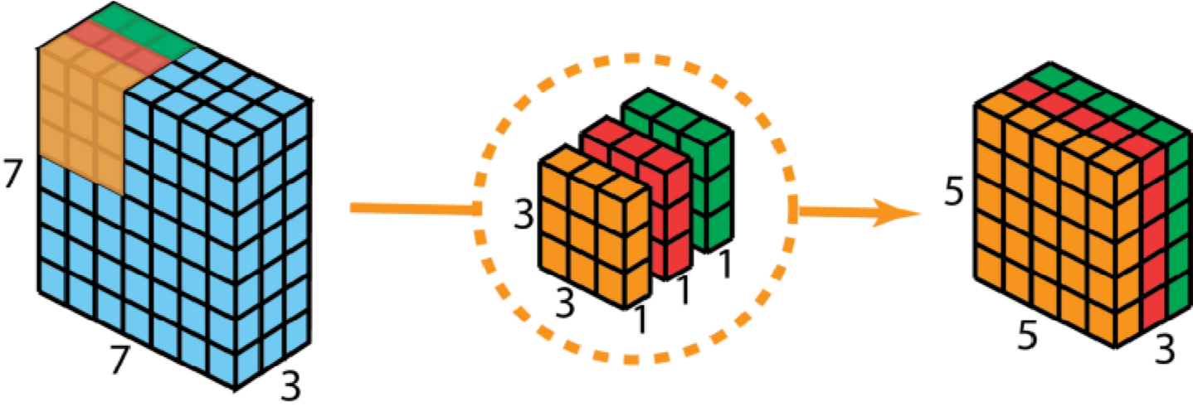
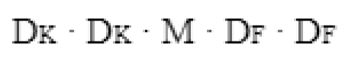
Depthwise convolution
The depthwise convolution used by MobileNets imposes singular kernels to each image depth, followed by a batch normalization and a ReLU block. The depthwise convolution's outputs are then combined using a 1x1 convolution by the pointwise convolution.
Complexity of Depthwise convolution:

Slide 13
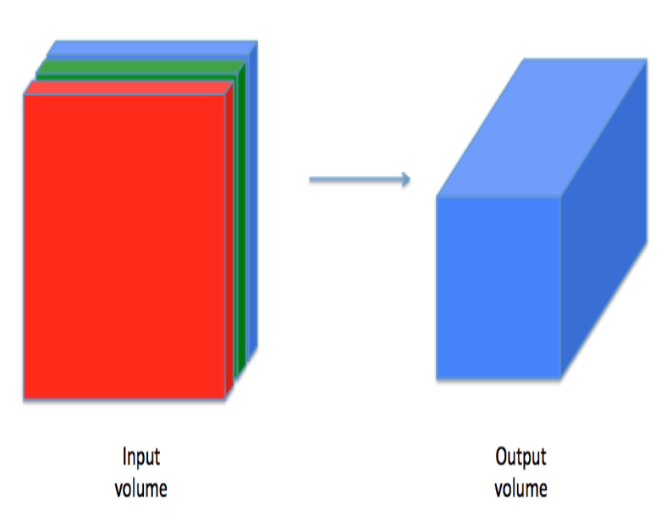
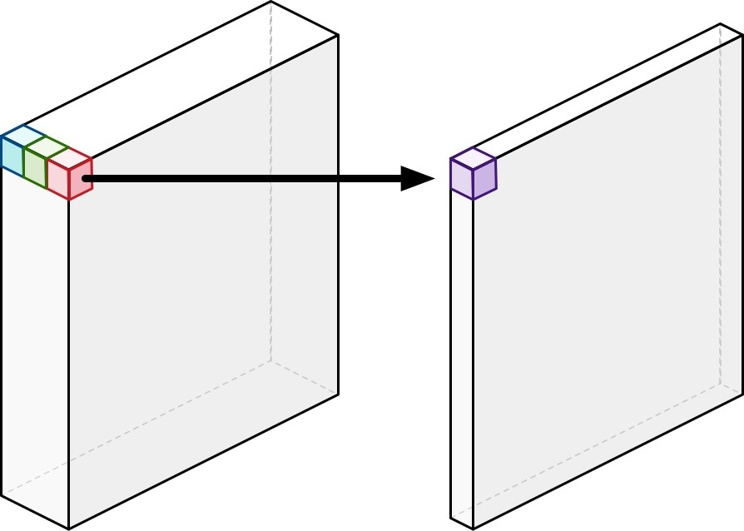
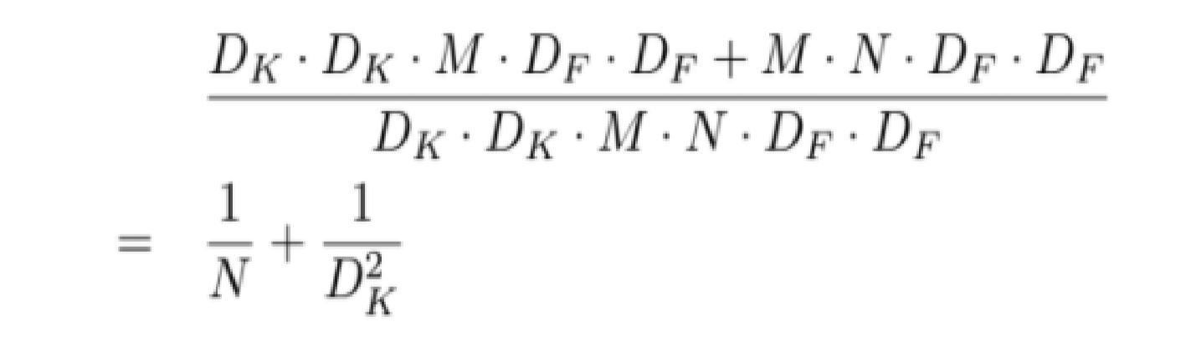
Pointwise convolution
The depthwise convolution's outputs are then combined using a 1x1 convolution by the pointwise convolution to combine the maps.
Complexity of Depthwise Convolution + Pointwise convolution:
Depthwise separable convolution over standard convolution complexity reduction:

Slide 14
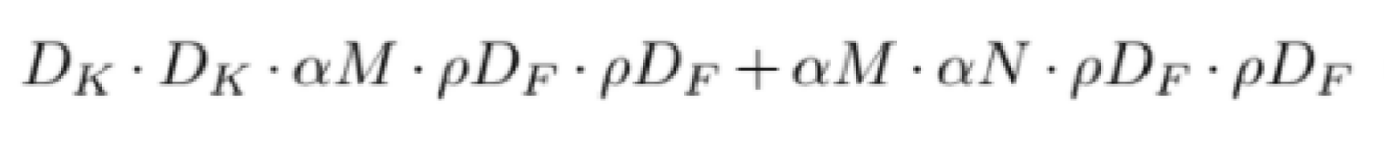
Mobilenet’s hyperparamaters
Shown below is the depthwise separable computational complexity, appended on to it is α (width multiplayer) and ρ ( resolution multiplier). These variables can fundamentally reduce computational cost and resolution of parameters. Both are used in our own Mobilenet implementations.

Slide 15
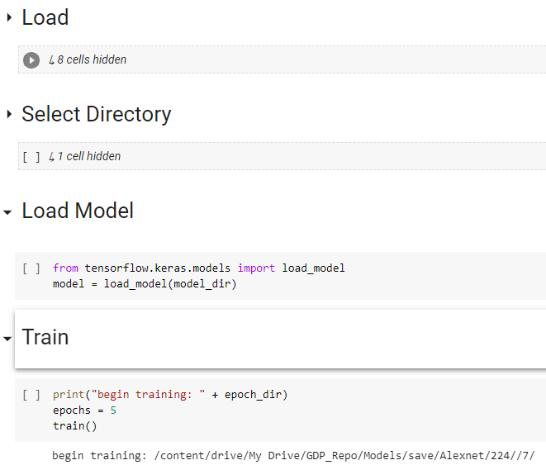
Model - Architectures
Alexnet
224x224
128x128
MobileNet
224x224(1 & 0.25)
128x128(1 & 0.25)

Slide 16
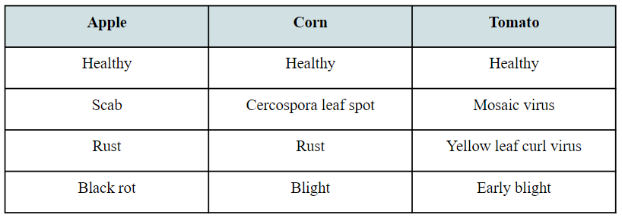
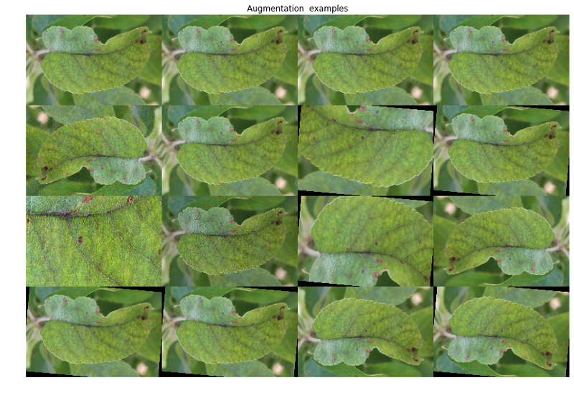
Model - Dataset
PlantVillage: 22,700 images
Accuracy Paradox
Image Augmentation

Slide 17
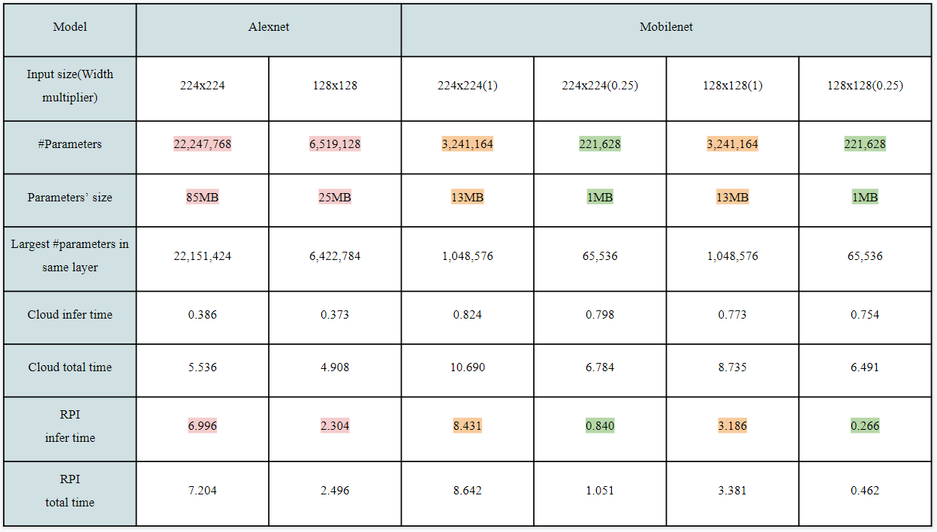
Model - Metrics

Slide 18
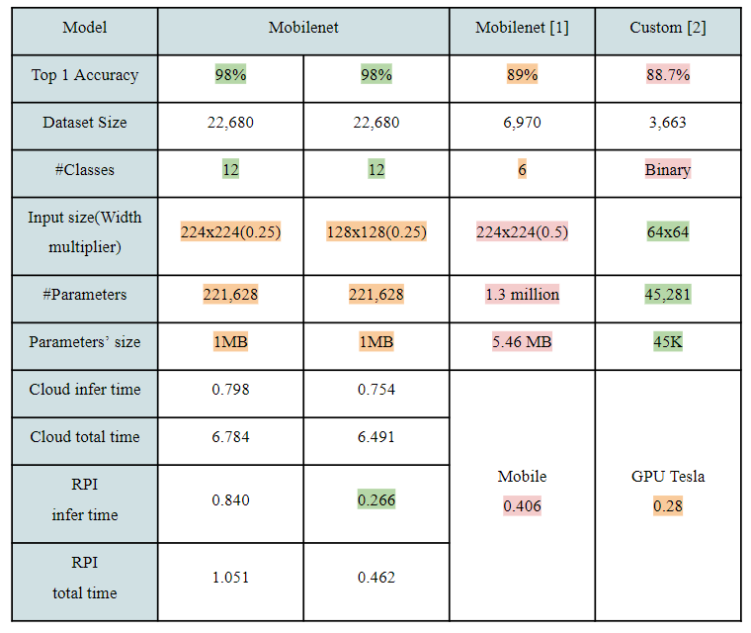
Model - Comparison

Slide 19
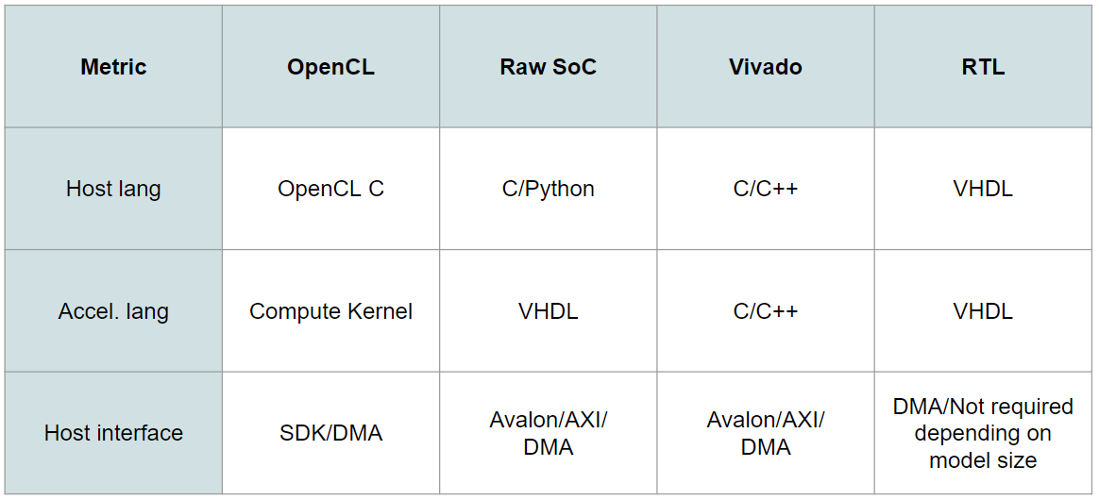
CNN on FPGA
Vivado
OpenCL
Raw Implementation
RTL

Slide 20
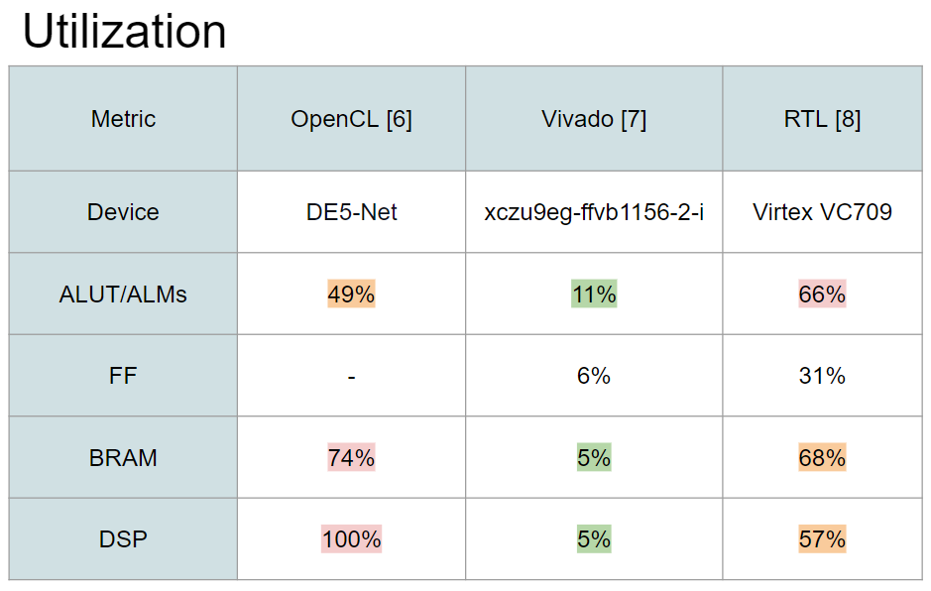
CNN on FPGA - Utilization

Slide 21
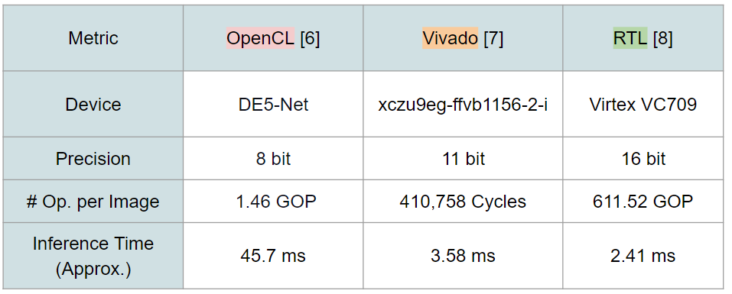
CNN on FPGA - Performance

Slide 22
Input Layer
The Input Layer task is
To receive the input image of the CNN
To store this image to memories ROMS
To create the input of the Convolution Layer

Slide 23
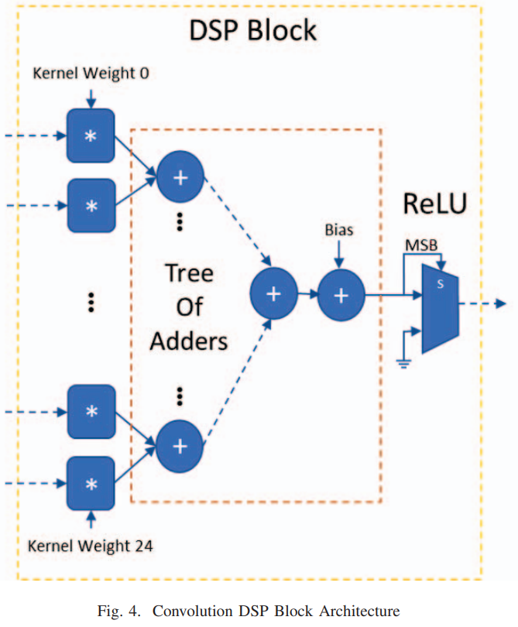
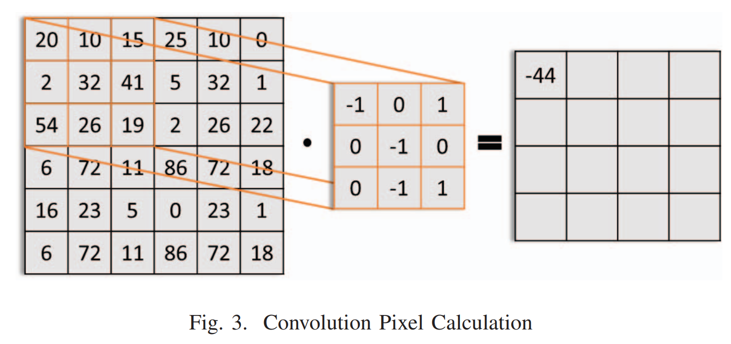
Convolution Layer

Slide 24
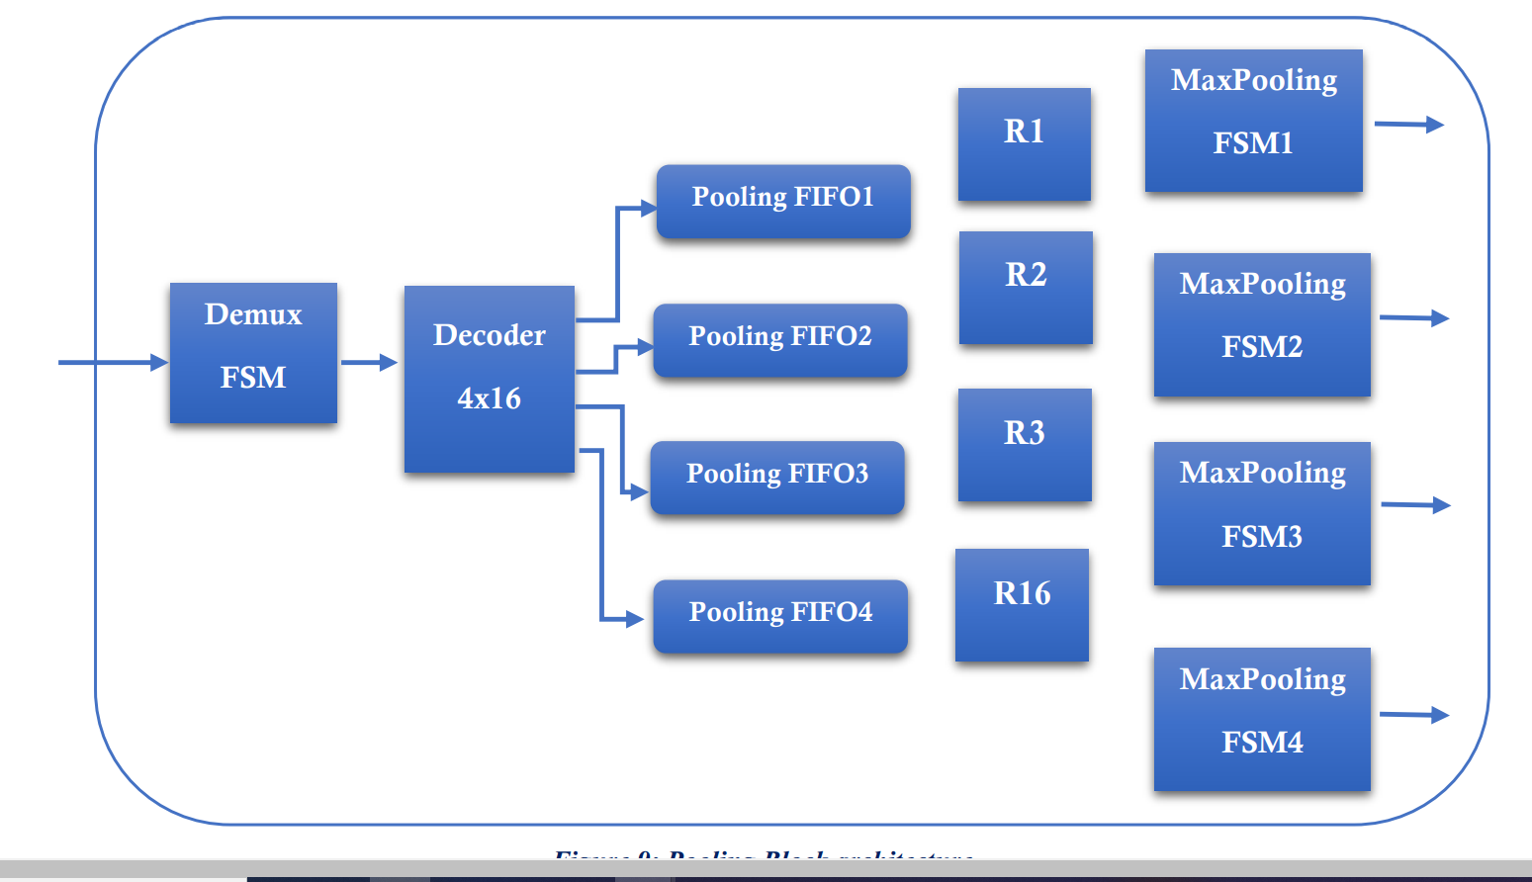
Pooling Layer
Demux FSM: Receives rows of data from the corresponding DSP block and store them in four pooling FIFOS through a 4x16 decoder
Four pooling FIFOS: Stores and forward the values of pixels
Sixteen registers: Stores the pixels from each pooling FIFO in order to create the 2x2 windows
Max Pooling FSMs: Calculate the maximum value of 4 pixels window and outputs the result

Slide 25
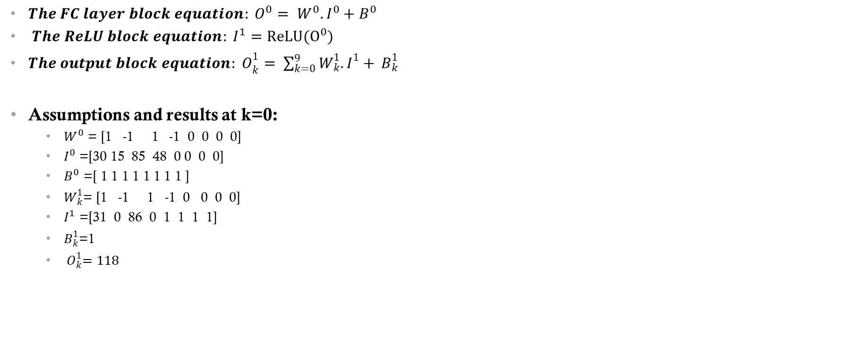
Fully Connected Layer

Slide 26
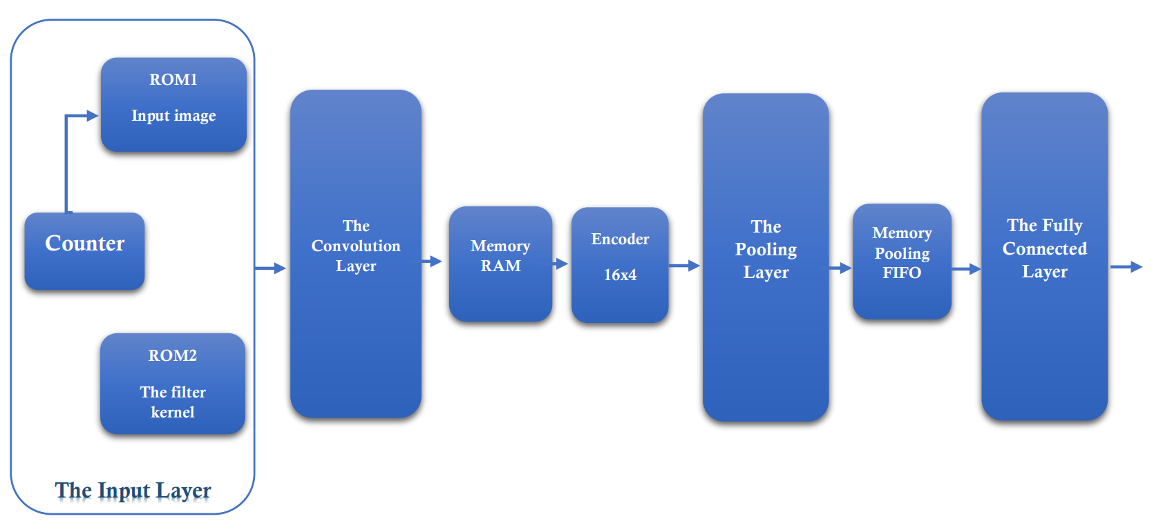
Overall Design Architecture

Slide 27
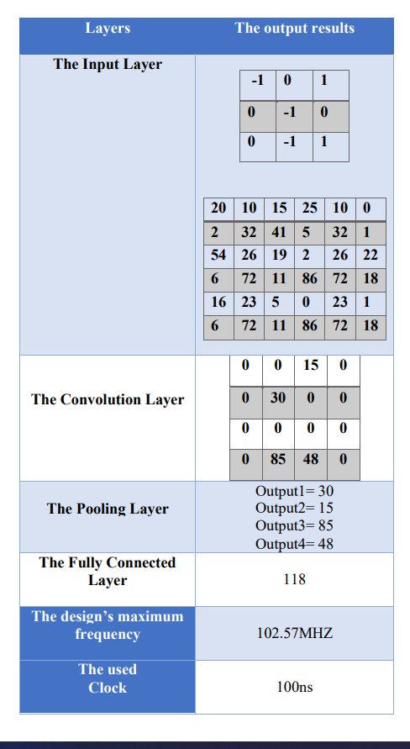
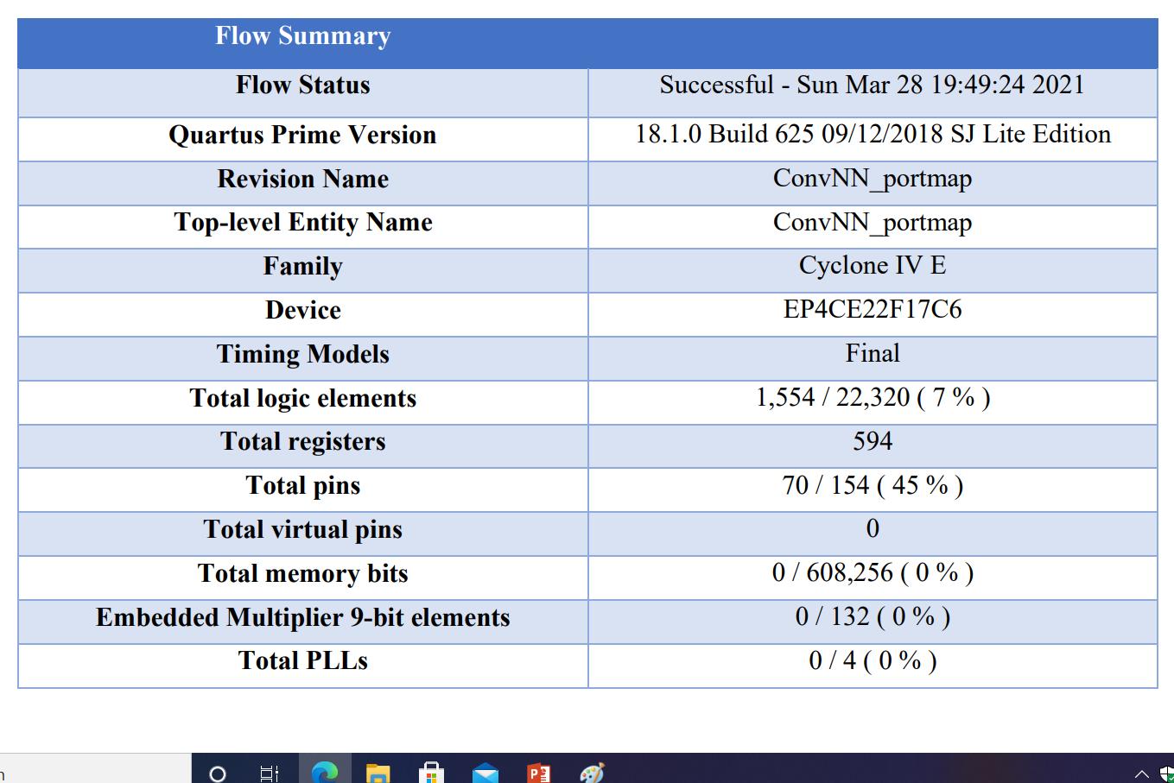
Quartus resources and outputs for the overall Design

Slide 28
Algorithms needed in CNN Microprocessor
Batch Normal Layer
Convolutional Layer
FC Layer
Global Pool Layer
Relu Layer
Sigmoid Layer

Slide 29
Components needed in CNN Microprocessor
DIV
SQRT
EXP

Slide 30
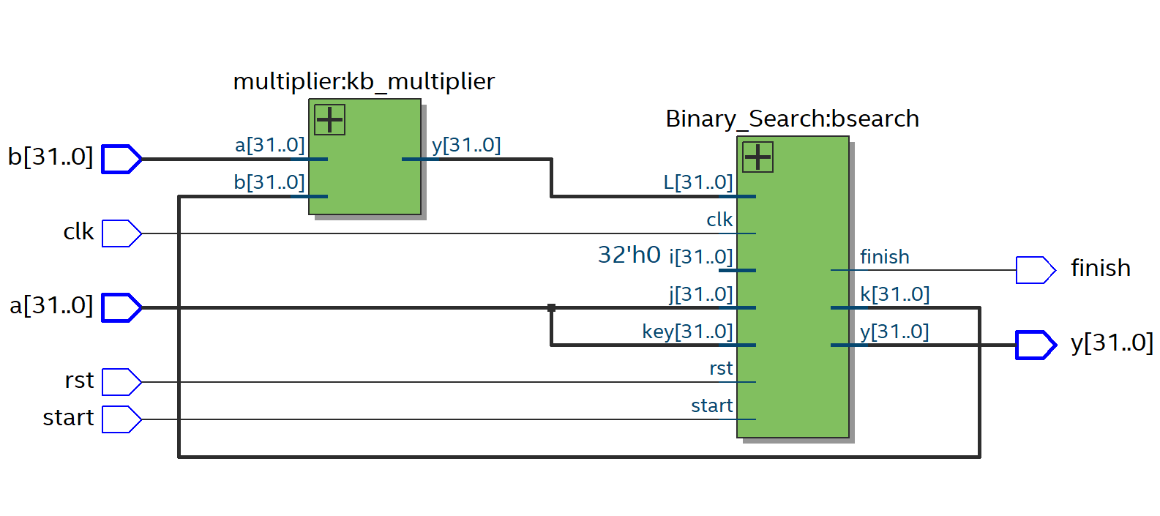
Division

Slide 31
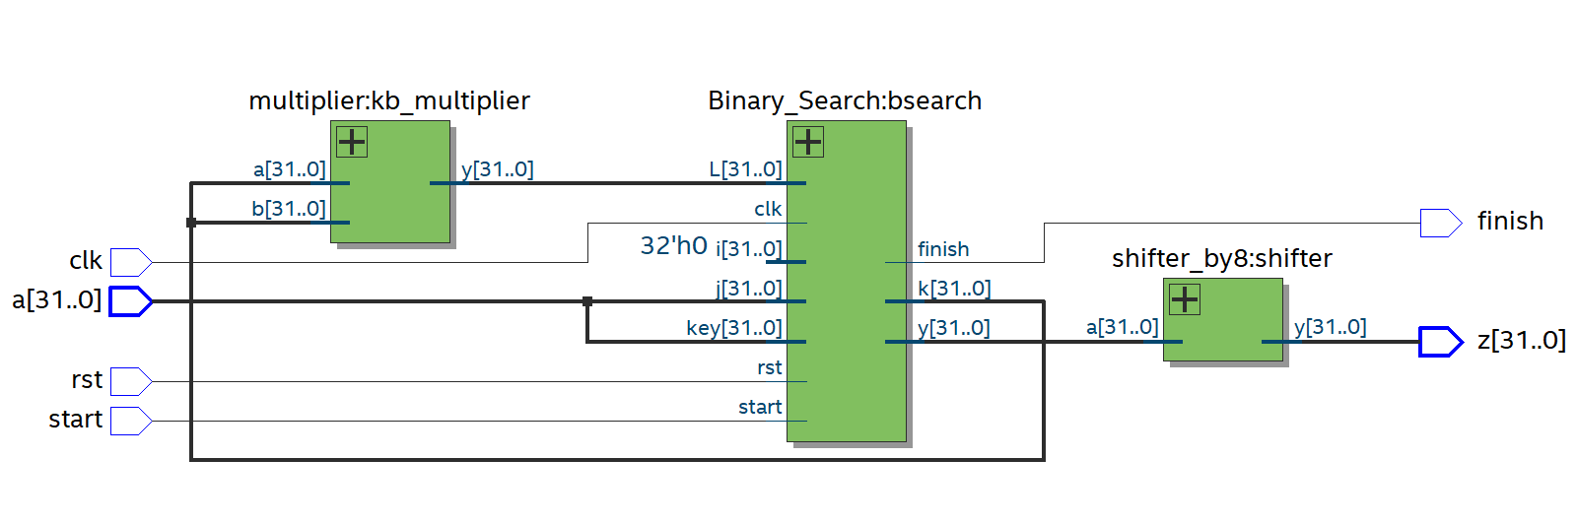
Square Root

Slide 32
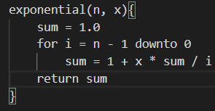
Exponential

Slide 33
Achievements
Understanding of functional and nonfunctional requirements of the project
Encompassing the principles of Convolutional Neural Network.
Gathering data regarding current advancements and ongoing research on image feature detection and applications in plant leaf disease detection. As well as top of the line advancements in research regarding FPGA CNN implementations.
Acquiring practical knowledge on frameworks and tools used for our implementations.
Full application DEMO on Raspberry Pi platform.
Basis implementation of CNN architecture on FPGA platform.

Slide 34
Future Goals
Creating low level implementation of Mobilenet models.
Applying applicational models into FPGA devices using HLS and RTL.
Iteration and performance evaluation.

Slide 35
References
Kyriakos, A. (2019). High Performance Accelerator for CNN Applications. 29th International Symposium on Power and Timing Modeling, Optimization and Simulation (PATMOS 2019) (pp. 135-140). Athens: c 2019 IEEE .
D. Steinkraus, I. Buck, and P. Y. Simard, “Using GPUs for machine learning algorithms,” in Eighth International Conference on Document Analysis and Recognition (ICDAR 05), 2005.
K. Ovtcharov, O. Ruwase, J. Kim, J. Fowers, K. Strauss, and E. S. Chung, “Accelerating Deep Convolutional Neural Networks Using Specialized Hardware,” Microsoft Res. Whitepaper, 2015. 56

Slide 36
Thank you

